Slide 1
Draft 2023 Air Emissions Guides for Air Force Sources
5 May 2023
Solutio Environmental Inc, 5/10/2023
FRANK CASTANEDA, III, P.E.
Air Quality Subject Matter Expert
AFCEC Environmental Quality
HQ AFCEC/CZTQ
Your Success is Our Mission!

Slide 2
Purpose
Provide an overview of the major revisions/changes captured in the Draft 2023 Air Emissions Guides for Air Force Sources

Slide 3
Where to Get the Draft Guides
Each individual guide has a dedicated download link and response email address:
Air Emissions Guide for Air Force Stationary Sources
Download at: https://aqhelp.com/Stationary2023/
Send completed comment matrix to: Stationary2023@aqhelp.com
Air Emissions Guide for Air Force Mobile Sources
Download at: https://aqhelp.com/Mobile2023/
Send completed comment matrix to: Mobile2023@aqhelp.com
Air Emissions Guide for Air Force Transitory Sources
Download at: https://aqhelp.com/Transitory2023/
Send completed comment matrix to: Transitory2023@aqhelp.com

Slide 4
Review Process
When you open one of the dedicated download links you will be able to download the draft guide and associated comment matrix
All comments must be submitted in the dedicated comment matrix, no other format will be accepted due to time constraints
Upon completion of your comments on a specific guide, email your comment matrix to the dedicated email address for that guide
All Comments due NLT 19 May 2023

Slide 5
Stationary Guide
Notes:
5

Slide 6
Stationary Guide Ch. 1 - Introduction
REVISED: Criteria Pollutant Corrections:
Sulfur Dioxide (SO₂) to Sulfur Oxide (SO_{x})
Regulated as Sulfur Dioxide (SO₂)
Nitrogen Dioxide (NO₂) to Nitrogen Oxide (NO_{x})
Regulated as Nitrogen Dioxide (NO₂)
Note that the EPA generally gets this wrong in their websites and documents

Slide 7
Stationary Guide All Chapters
NEW: Speciated GHG EFs to all sources
Carbon dioxide (CO₂)
Methane (CH₄), and
Nitrogen dioxide (N₂O)
CO₂ equivalents (CO₂e), based on Global Warming Potentials (GWP)
CO₂e = (CO₂ x 1 GWP) + (CH₄ x 25 GWP) + (N₂O x 298 GWP)

Slide 8
Stationary Guide All Chapters
Speciated GHG EFs added to the following:
Ch. 2 – External Combustion (ECOM)
Table 2-4. GHG Emission Factors for Natural Gas-Fired ECOM Units
Table 2-7. GHG Emission Factors for Fuel Oil-Fired ECOM Units
Table 2-10. GHG Emission Factors for Bituminous/ Subbituminous Coal-Fired ECOM
Table 2-13. GHG Emission Factors for LPG-Fired ECOM Units
Table 2-16. GHG Emission Factors for Waste Oil-Fired ECOM Units
Table 2-19. GHG Emission Factors for Digester Gas Flares (Enclosed)
Ch. 3 – Internal Combustion (ICOM)
Table 3-6. GHG Emission Factors for Stationary Compression Ignition ICOM Engines
Table 3-9. GHG Emission Factors for Stationary Spark Ignition ICOM Engines
Table 3-12. GHG Emission Factors for Stationary Turbine ICOM Engines

Slide 9
Stationary Guide All Chapters
Speciated GHG EFs added to the following:
Ch. 12 – Fire Fighter Training (FIRE)
Table 12-2. GHG Emission Factors for Burned Fuel During Fire Fighter Training
Table 12-4. GHG Emission Factors for Burned Materials During Fire Fighter Training
Ch. 14 – Incinerators
Table 14-2. GHG Emission Factors for Classified Waste Incinerators
Table 14-4. GHG Emission Factors for Medical Waste Incinerators
Ch. 16 – Munitions OB/OD
Table 16-2. GHG Emission Factors for Open Burn/Open Detonation
Ch. 19 – Small Arms Firing Range
Table 19-2. GHG Emission Factors for Cartridges Used at Small Arms Firing Ranges
Ch. 20 – Static Rocket Engine Testing
Table 20-2. GHG Emission Factors for Rocket Engine Testing

Slide 10
Stationary Guide Ch. 35 Site Remediation
REVISED: Site Remediation
Expand discussion on rescinding exemptions from CAA
Resource Conservation and Recovery Act (RCRA) exemption
Comprehensive Environmental Response, Compensation, and Liability Act (CERCLA)
Stationary vs Transitory Source?
Current Guide
Exempt source under RCRA/CERCLA; therefore, USAF did not consider this a stationary source of emissions
Revised Guide
For Major Sources of HAPs only, NESHAP removes RCRA/CERCLA exemption

Slide 11
Mobile Guide
Notes:
11

Slide 12
Mobile Guide All Chapters
NEW: Speciated GHG EFs to all sources
Carbon dioxide (CO₂)
Methane (CH₄), and
Nitrogen dioxide (N₂O)
CO₂ equivalents (CO₂e), based on Global Warming Potentials (GWP)
CO₂e = (CO₂ x 1 GWP) + (CH₄ x 25 GWP) + (N₂O x 298 GWP)

Slide 13
Mobile Guide Ch. 1 Introduction
REVISED: Criteria Pollutant Corrections:
Revised definition of VOCs to reflect definition in 40 CFR 51.100
Sulfur Dioxide (SO₂) to Sulfur Oxide (SO_{x})
Regulated as Sulfur Dioxide (SO₂)
Nitrogen Dioxide (NO₂) to Nitrogen Oxide (NO_{x})
Regulated as Nitrogen Dioxide (NO₂)
Note that the EPA generally gets this wrong in their websites and documents

Slide 14
Mobile Guide Ch. 2 Aircraft Flight Operations
NEW: Total rewrite of chapter
Most extensive revision of the guide
NEW: Separated Aircraft Flight Operations by aircraft type:
Fixed-Wing Aircraft: Also known as planes, are heavier-than-air flying machines that are capable of flight by using wings to generate lift via the aircraft’s forward airspeed and the shape of the wings
Rotary Aircraft: Also known as helicopters, are heavier-than-air flying machines that use rotary wings or blades to generate lift

Slide 15
Mobile Guide Ch. 2 Aircraft Flight Operations
REVISED: Mixing Height
Under the EPA procedures:
A criteria pollutant emissions inventory for aircraft operations focuses only on pollutants emitted in the vertical column of air referred to as the “mixing zone”
Mixing zone is the lower atmospheric layer where air pollutant chemical reactions occur and above which there is a negligible effect on ground-level air pollution
Default mixing zone height (mixing height) defined by the EPA is 3,000 ft AGL
Greenhouse Gasses (GHGs)
Unlike criteria pollutants, the impact of GHGs is at global-scale
GHGs chemical reactions occur below and above the mixing height
Given the mixing height is only associated with microscale criteria pollutant modeling, use of the mixing height for GHG modelling could be inadequate
While the mixing height constraint does not account for all GHGs, it does establish a fixed and consistent reference point for calculating emissions that can be used in a “relative comparison analysis” amongst alternatives

Slide 16
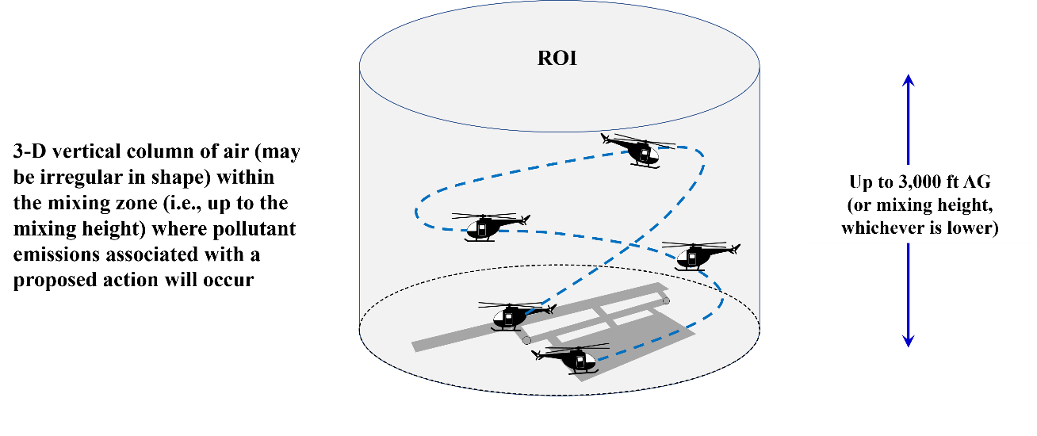
Mobile Guide Ch. 2 Aircraft Flight Operations
NEW: Region of Influence (ROI)
There may be more than one ROI due to the physical and spatial distribution of the emissions sources associated with the proposed action

Slide 17
Mobile Guide Ch. 2 Aircraft Flight Operations
NEW: Three basic “Flight Cycles” for both fixed-wing and rotary aircraft:
Landing and Takeoff (LTO) Cycle: A flight operation consisting of one complete repetitive takeoff and landing cycle.
Low Flight Pattern (LFP) Cycle: A flight operation consisting of one complete repetitive flight cycle below the mixing height that does not include any part of a LTO or CP cycle.
Closed Pattern (CP) Cycle: A flight operation consisting of one complete repetitive flight maneuver that involves practice landing on a runway by briefly touching the landing gear to the runway, or coming very close, and transitioning immediately into climb out and associated flying to maneuver into another practice landing

Slide 18
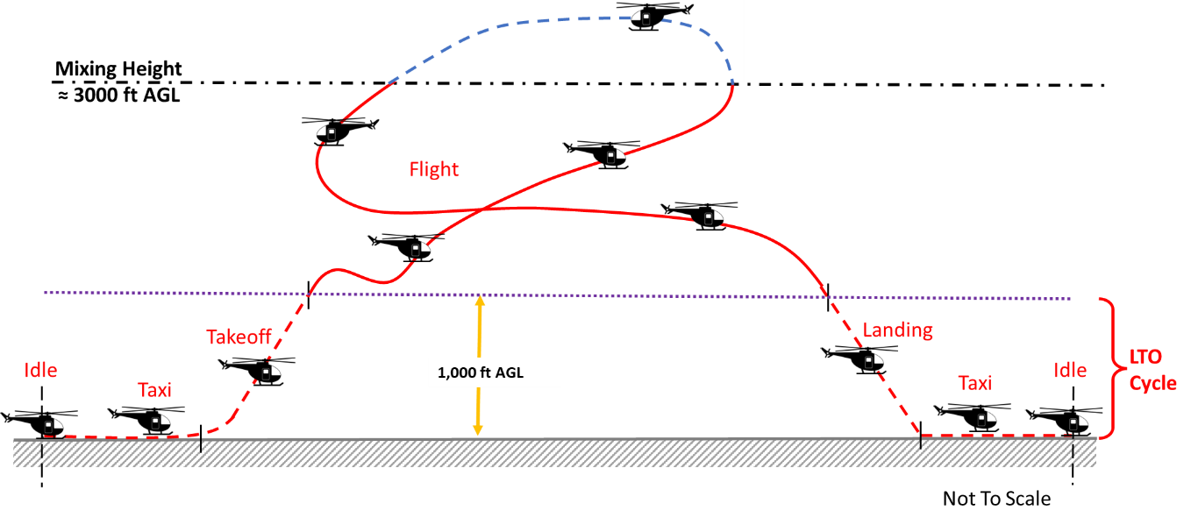
Mobile Guide Ch. 2 Aircraft Flight Operations
NEW: Rotary (Helicopter) Aircraft Flight Operations:
Totally new modeling methodology
Rotary aircraft flight patterns are described in terms of “flying phase” rather than “flight modes” (as with fixed-wing aircraft).

Slide 19
Mobile Guide Ch. 2 Aircraft Flight Operations
REVISED: Various other revisions:
Table 2-3, Speciated GHG EFs
New speciated GHG EFs table for Jet Fuel and AVGAS
Table 2-5, Default TIM Table
Update with new AF- collected data
Combined Taxi-in and Taxi-out columns
Removed Rotary category from Table (no defaults for rotary)
Criteria Pollutant EF Table
Separated into two tables: Fixed-Wing Table and Rotary Table
Corrected EF for aircraft using AVGAS

Slide 20
Mobile Guide Changes
REVISED: Ch. 4 – Non-Road Engines and Equipment
Updated tables to reflect new data from Nonroad (MOVES and EMFAC)
Tables 4-1 to 4-5, Criteria Pollutant EFs for Non-Road Engines and Equipment
New EF for CY 2023 - 2027
REVISED: Ch. 5 – On-Road Vehicles
Updated Typical Air Force Vehicle Mix
Table 5-2, Typical Air Force POV & GOV Mix
Table 5-3, GOV Tactical and Non-Tactical Vehicle Mix
Updated tables to reflect new data from MOVES and EMFAC
Tables 5-9 to 5-17, On-Road Vehicle Composite EFs (MOVES)
Table 5-18 to 5-24, On-Road Vehicle EFs (MOVES)
Table 5-23 to 5-30, On-Road Vehicle Composite EFs (EMFAC)
Table 5-31 to 5-34, On-Road Vehicle EFs (EMFAC)

Slide 21
Transitory Guide
Notes:
21

Slide 22
Transitory Guide All Chapters
NEW: Speciated GHG EFs to all sources
Carbon dioxide (CO₂)
Methane (CH₄), and
Nitrogen dioxide (N₂O)
CO₂ equivalents (CO₂e), based on Global Warming Potentials (GWP)
CO₂e = (CO₂ x 1 GWP) + (CH₄ x 25 GWP) + (N₂O x 298 GWP)

Slide 23
Transitory Guide Ch. 1 Introduction
REVISED: Criteria Pollutant Corrections:
Revised definition of VOCs to reflect definition in 40 CFR 51.100
Sulfur Dioxide (SO₂) to Sulfur Oxide (SO_{x})
Regulated as Sulfur Dioxide (SO₂)
Nitrogen Dioxide (NO₂) to Nitrogen Oxide (NO_{x})
Regulated as Nitrogen Dioxide (NO₂)
Note that the EPA generally gets this wrong in their websites and documents

Slide 24
Transitory Guide Ch. 3 Burn, Open and Prescribed
NEW: Removed Prescribed Burns
Existing Open Burn methodology was erroneously used for Prescribed Burns
Combined Prescribed Burns with Wild Fire and moved to a new chapter
NEW: Chapter now call “Burn, Open”
Open burning can be done in open drums or baskets, in fields and yards, and in large open dumps

Slide 25
Transitory Guide Ch. 4 Construction
Separated Trench/Excavation into two construction phases
While they are both excavation activities, they are slightly different and people were forgetting to add trenching when they also has excavation
NEW: New equation for Off-Road Equipment emissions
NEW: Revised example calculations
REVISED: All Off-Road Equipment EFs based on revised 2022 California Emission Estimator Model (CalEEMod)
Updated Tables 4-3 to 4-8 (new units for new equation)
NEW: Tables to speciate GHGs
New Tables 4-8 to 4-14
NEW: Table for Off-Road Equipment default horsepower and load factors (Table 4-15)

Slide 26
Transitory Guide Ch. 9 Site Remediation
NESHAP for Site Remediation, 40 CFR 63 Subpart GGGGG (5G), removes the RCRA/CERCLA exemption from CAA
Select remediation sources may now potentially be stationary sources
Process vents, tanks, containers, separators, transfer systems, and leaks
Only applies if remediation is collocated at a major source of HAPs and subject to various additional 5G requirements
NEW: Chapter revised to address removal of the exemption
Stationary vs Transitory Source
Currently all remediation is Transitory except for about 5 facilities AF-wide
If 5G is applicable, affected sources are “stationary sources” and must be included in annual reporting and permitting
Other requirements may apply
If 5G is not applicable, affected sources are “transitory sources” and on-site remedial actions must attain or exceed 5G emissions limits as an Applicable or Relevant and Appropriate Requirement (ARAR)

Slide 27
Transitory Guide Ch. 11 Wildfires and Prescribed Burning
NEW: Chapter was only “Wildfire” now called “Wildfires and Prescribed Burning”
NEW: Removed Prescribed Burns from Chapter 3 and combined with Wildfires in this chapter
Existing Open Burn methodology was erroneously used for Prescribed Burns
NEW: Total rewrite of chapter
Most extensive revision of the guide
Newly developed emission methodologies and models for both Prescribed Fires and wildfires

Slide 28
Transitory Guide Ch. 11 Wildfires and Prescribed Burning
NEW: Forest Regions and default Fuel Loading

Slide 29
Transitory Guide Ch. 11 Wildfires and Prescribed Burning
NEW: New Wildfire emissions methodology
Revised EFs for criteria pollutants
New EFs for GHGs speciation
New algorithm

Slide 30
Transitory Guide Ch. 11 Wildfires and Prescribed Burning
NEW: New Prescribed Burning emissions methodology
Revised EFs for criteria pollutants
New EFs for GHGs speciation
New algorithm
New default Fuel Load Composition factors by Forest Regions

Slide 31
Reminder
Notes:
31

Slide 32
Draft Document Review
Air Emissions Guide for Air Force Stationary Sources
Download at: http://aqhelp.com/Stationary2023/
Send completed comment matrix to: Stationary2023@aqhelp.com
Air Emissions Guide for Air Force Mobile Sources
Download at: http://aqhelp.com/Mobile2023/
Send completed comment matrix to: Mobile2023@aqhelp.com
Air Emissions Guide for Air Force Transitory Sources
Download at: http://aqhelp.com/Transitory2023/
Send completed comment matrix to: Transitory2023@aqhelp.com
All Comments due NLT 19 May 2023

Slide 33
Questions?

